Slide 1
What is the difference from traditional & modern kids

Slide 2
Overview
1. Habbit
2. Interest
3. Behavior

Slide 3
1. Habbit

Slide 4
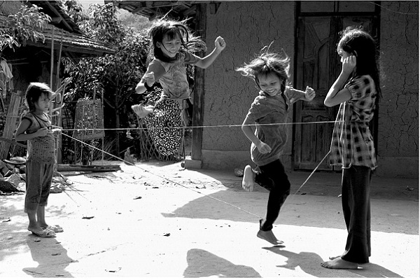
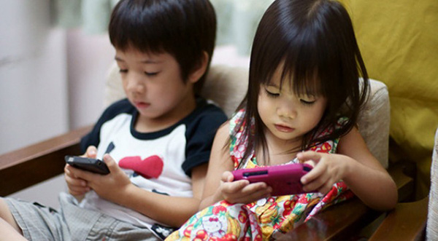
2. Interest

Slide 5
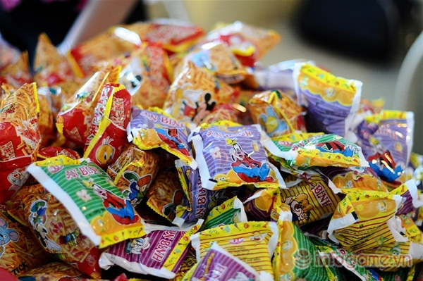
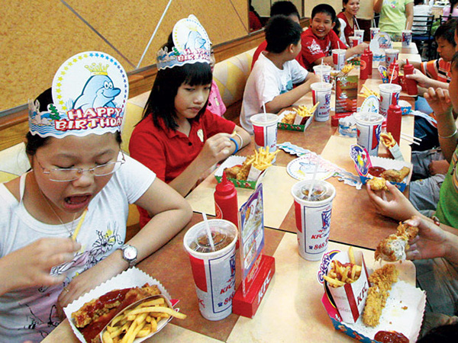
2. Interest

Slide 6
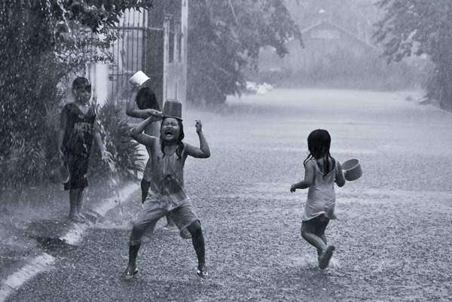
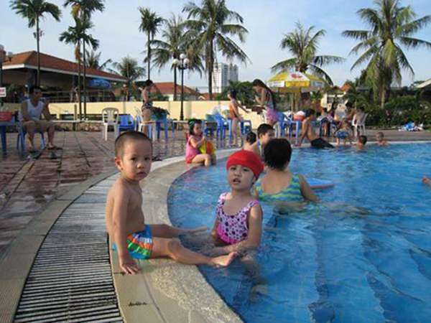
2. Interest

Slide 7
3. Behavior

Slide 8
Q & A

